Slide 1
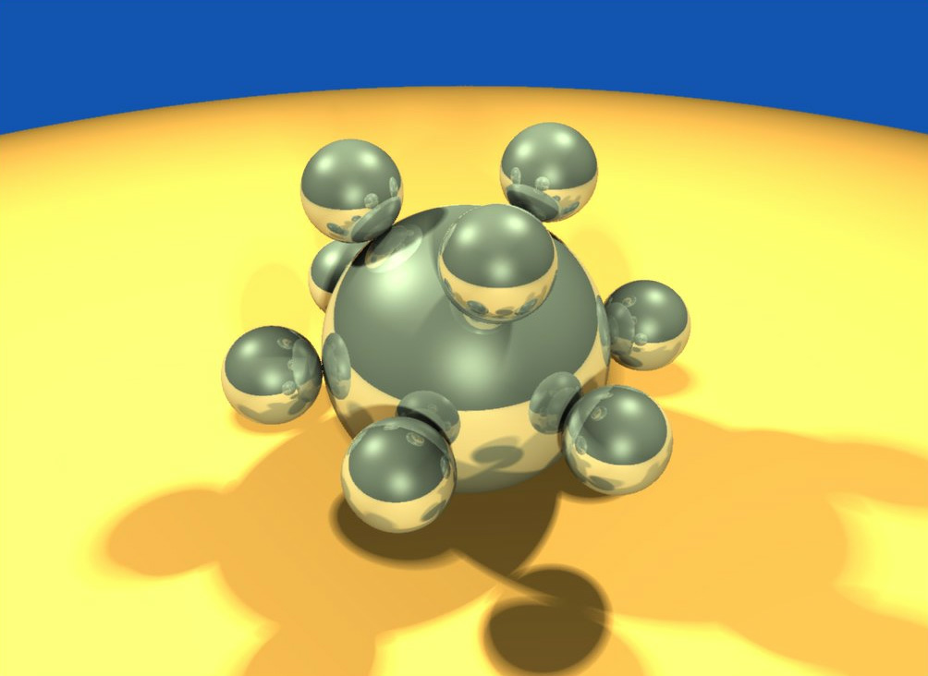
Computer Graphics using OpenGL, 3rd Edition
F. S. Hill, Jr. and S. Kelley
Chapter 5.1-2
Transformations of Objects
S. M. Lea
University of North Carolina at Greensboro
© 2007, Prentice Hall

Slide 2
Transformations
We used the window to viewport transformation to scale and translate objects in the world window to their size and position in the viewport.
We want to build on this idea, and gain more flexible control over the size, orientation, and position of objects of interest.
To do so, we will use the powerful affine transformation.

Slide 3
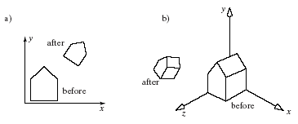
Example of Affine Transformations
The house has been scaled, rotated and translated, in both 2D and 3D.

Slide 4
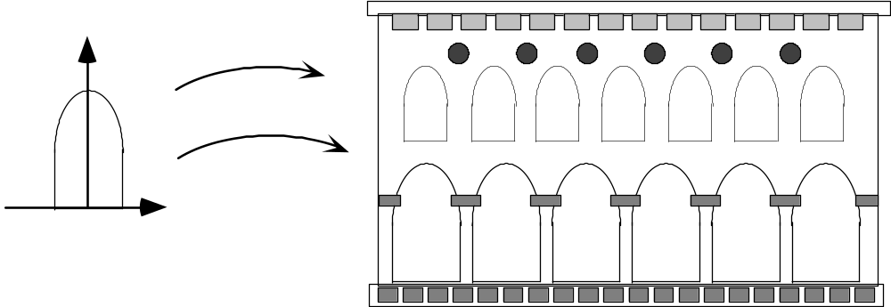
Using Transformations
The arch is designed in its own coordinate system.
The scene is drawn by placing a number of instances of the arch at different places and with different sizes.

Slide 5
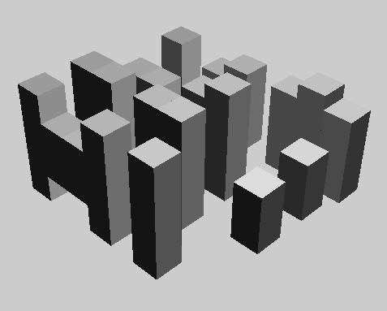
Using Transformations (2)
In 3D, many cubes make a city.

Slide 6
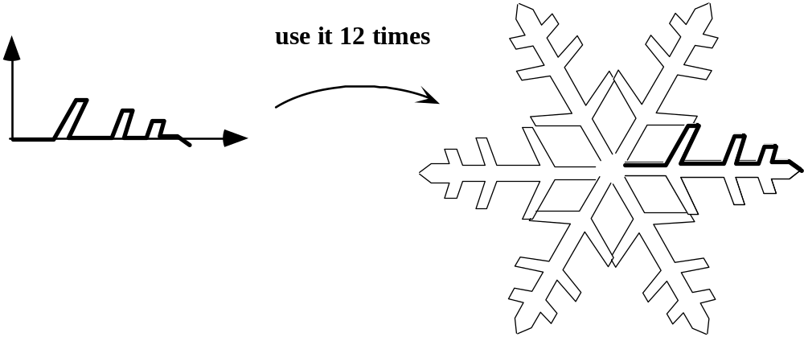
Using Transformations (3)
The snowflake exhibits symmetries.
We design a single motif and draw the whole shape using appropriate reflections, rotations, and translations of the motif.

Slide 7
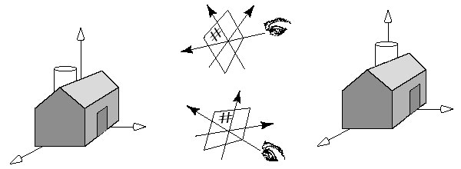
Using Transformations (4)
A designer may want to view an object from different vantage points.
Positioning and reorienting a camera can be carried out through the use of 3D affine transformations.

Slide 8
Using Transformations (5)
In a computer animation, objects move.
We make them move by translating and rotating their local coordinate systems as the animation proceeds.
A number of graphics platforms, including OpenGL, provide a graphics pipeline: a sequence of operations which are applied to all points that are sent through it.
A drawing is produced by processing each point.

Slide 9
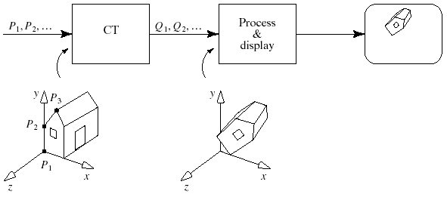
The OpenGL Graphics Pipeline
This version is simplified.

Slide 10
Graphics Pipeline (2)
An application sends the pipeline a sequence of points P₁, P₂, ... using commands such as:
glBegin(GL_LINES);
glVertex3f(...); // send P1 through the pipeline
glVertex3f(...); // send P2 through the pipeline
...
glEnd();
These points first encounter a transformation called the current transformation (CT), which alters their values into a different set of points, say Q₁, Q₂, Q₃.

Slide 11
Graphics Pipeline (3)
Just as the original points P_{i} describe some geometric object, the points Q_{i} describe the transformed version of the same object.
These points are then sent through additional steps, and ultimately are used to draw the final image on the display.

Slide 12
Graphics Pipeline (4)
Prior to OpenGL 2.0 the pipeline was of fixed-functionality: each stage had to perform a specific operation in a particular manner.
With OpenGL 2.0 and the Shading Language (GLSL), the application programmer could not only change the order in which some operations were performed, but in addition could make the operations programmable.
This allows hardware and software developers to take advantage of new algorithms and rendering techniques and still comply with OpenGL version 2.0.

Slide 13
Transformations
Transformations change 2D or 3D points and vectors, or change coordinate systems.
  An object transformation alters the coordinates of each point on the object according to the same rule, leaving the underlying coordinate system fixed.
  A coordinate transformation defines a new coordinate system in terms of the old one, then represents all of the object’s points in this new system.
Object transformations are easier to understand, so we will do them first.

Slide 14
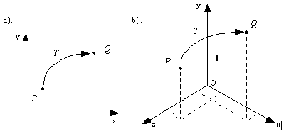
Transformations (2)
A (2D or 3D) transformation T( ) alters each point, P into a new point, Q, using a specific formula or algorithm: Q= T(P).

Slide 15
Transformations (3)
An arbitrary point P in the plane is mapped to Q.
Q is the image of P under the mapping T.
We transform an object by transforming each of its points, using the same function T() for each point.
The image of line L under T, for instance, consists of the images of all the individual points of L.

Slide 16
Transformations (4)
Most mappings of interest are continuous, so the image of a straight line is still a connected curve of some shape, although it’s not necessarily a straight line.
Affine transformations, however, do preserve lines: the image under T of a straight line is also a straight line.

Slide 17
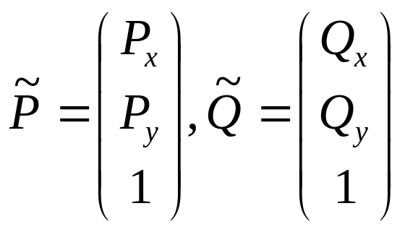
Transformations (5)
We use an explicit coordinate frame when performing transformations.
A coordinate frame consists of a point O, called the origin, and some mutually perpendicular vectors (called i and j in the 2D case; i, j, and k in the 3D case) that serve as the axes of the coordinate frame.
In 2D,

Slide 18
Transformations (6)
Recall that this means that point P is at location = P_{x} i + P_{y} j + O , and similarly for Q.
P_{x} and P_{y} are the coordinates of P.
To get from the origin to point P, move amount P_{x} along axis i and amount P_{y} along axis j.

Slide 19
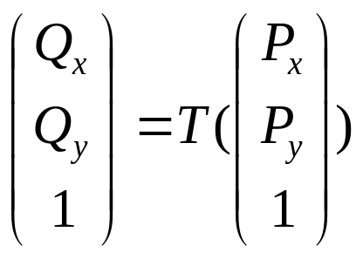
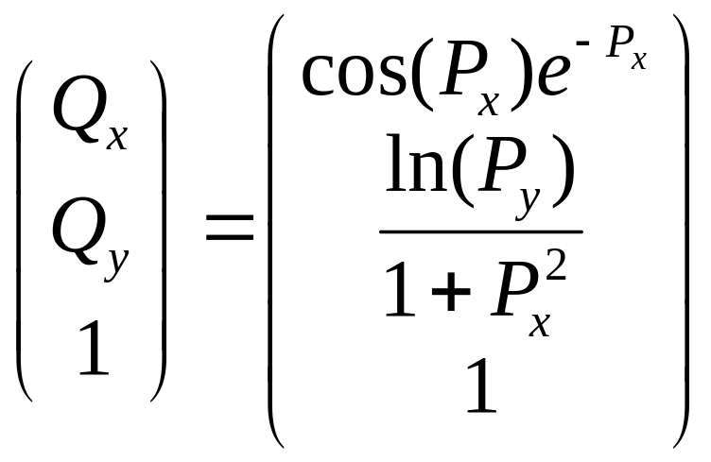
Transformations (7)
Suppose that transformation T operates on any point P to produce point Q:
or Q = T(P).
T may be any transformation: e.g.,

Slide 20
Transformations (8)
To make affine transformations we restrict ourselves to much simpler families of functions, those that are linear in P_{x} and P_{y}.
Affine transformations make it easy to scale, rotate, and reposition figures.
Successive affine transformations can be combined into a single overall affine transformation.

Slide 21
Affine Transformations
Affine transformations have a compact matrix representation.
The matrix associated with an affine transformation operating on 2D vectors or points must be a three-by-three matrix.
  This is a direct consequence of representing the vectors and points in homogeneous coordinates.

Slide 22
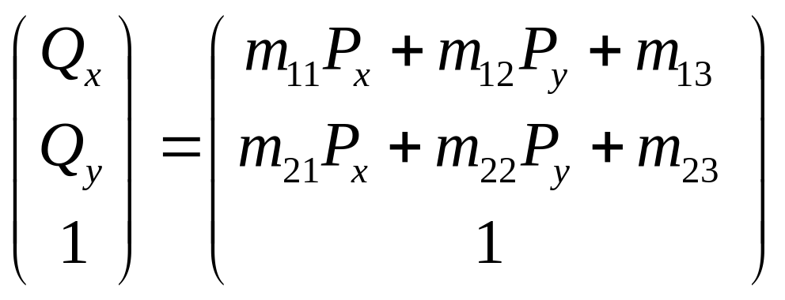
Affine Transformations (2)
Affine transformations have a simple form.
Because the coordinates of Q are linear combinations of those of P, the transformed point may be written in the form:

Slide 23
Affine Transformations (3)
There are six given constants: m₁₁, m₁₂, etc.
The coordinate Q_{x} consists of portions of both P_{x} and P_{y}, and so does Q_{y}.
This combination between the x- and y-components also gives rise to rotations and shears.

Slide 24
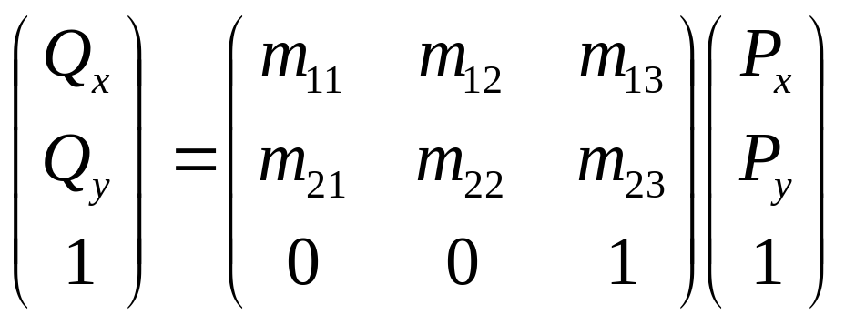
Affine Transformations (4)
Matrix form of the affine transformation in 2D:
For a 2D affine transformation the third row of the matrix is always (0, 0, 1).

Slide 25
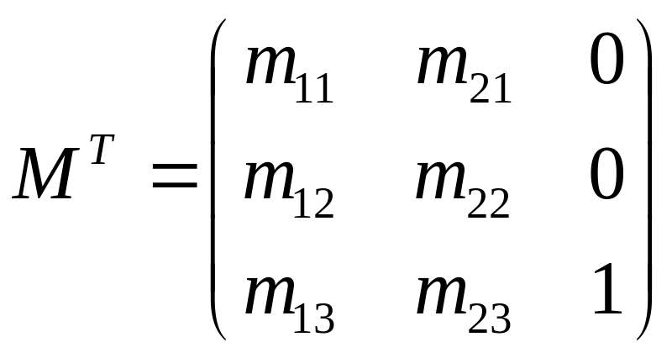
Affine Transformations (5)
Some people prefer to use row matrices to represent points and vectors rather than column matrices: e.g., P = (P_{x}, P_{y}, 1)
In this case, the P vector must pre-multiply the matrix, and the transpose of the matrix must be used: Q = P M^{T}.

Slide 26
Affine Transformations (6)
Vectors can be transformed as well as points.
If a 2D vector v has coordinates V_{x} and V_{y} then its coordinate frame representation is a column vector with third component 0.

Slide 27
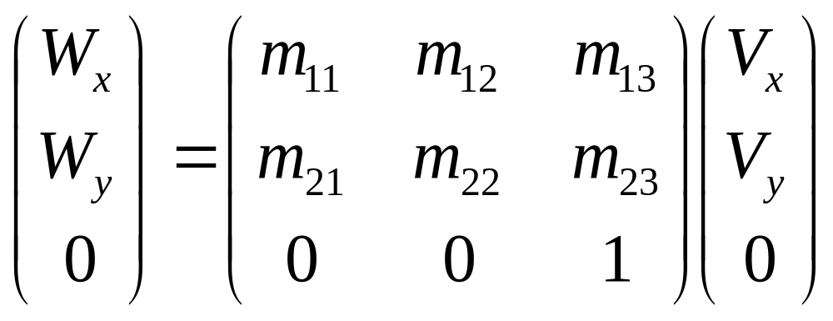
Affine Transformations (7)
When vector V is transformed by the same affine transformation as point P, the result is
Important: to transform a point P into a point Q, post-multiply M by P: Q = M P.

Slide 28
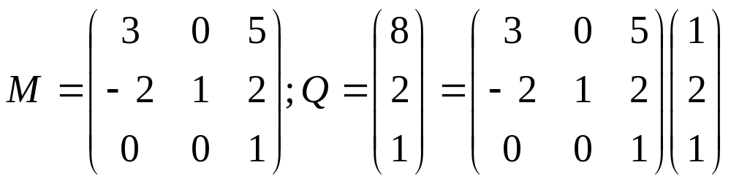
Affine Transformations (8)
Example: find the image Q of point P = (1, 2, 1) using the affine transformation

Slide 29
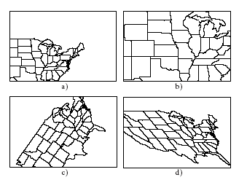
Geometric Effects of Affine Transformations
Combinations of four elementary transformations: (a) a translation, (b) a scaling, (c) a rotation, and (d) a shear (all shown below).

Slide 30
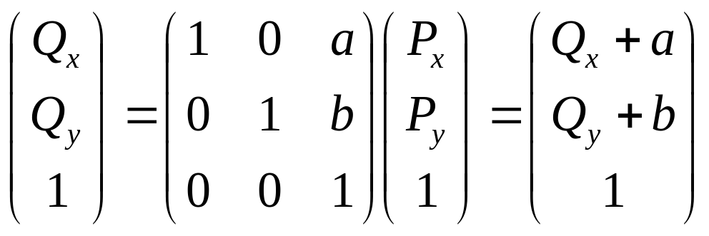
Translations
The amount P is translated does not depend on P’s position.
It is meaningless to translate vectors.
To translate a point P by a in the x direction and b in the y direction use the matrix:
Only using homogeneous coordinates allow us to include translation as an affine transformation.

Slide 31
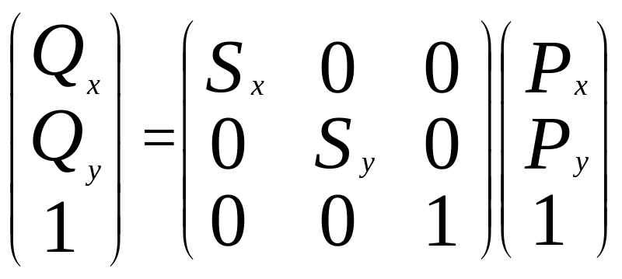
Scaling
Scaling is about the origin. If S_{x} = S_{y} the scaling is uniform; otherwise it distorts the image.
If S_{x} or S_{y} < 0, the image is reflected across the x or y axis.
The matrix form is

Slide 32
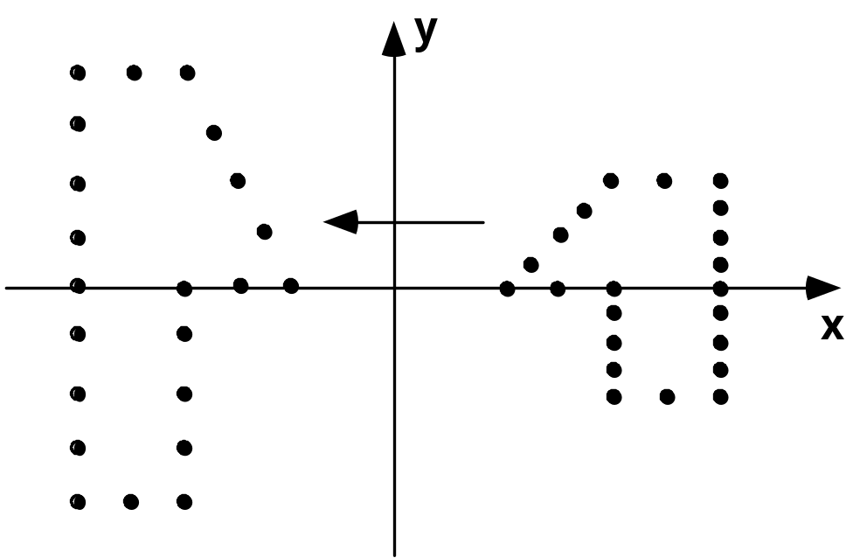
Example of Scaling
The scaling (Sx, Sy) = (-1, 2) is applied to a collection of points. Each point is both reflected about the y-axis and scaled by 2 in the y-direction.

Slide 33
Types of Scaling
Pure reflections, for which each of the scale factors is +1 or -1.
A uniform scaling, or a magnification about the origin: S_{x} = S_{y}, magnification |S|.
  Reflection also occurs if S_{x} or S_{y} is negative.
  If |S| < 1, the points will be moved closer to the origin, producing a reduced image.
If the scale factors are not the same, the scaling is called a differential scaling.

Slide 34
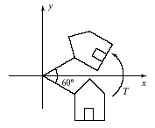
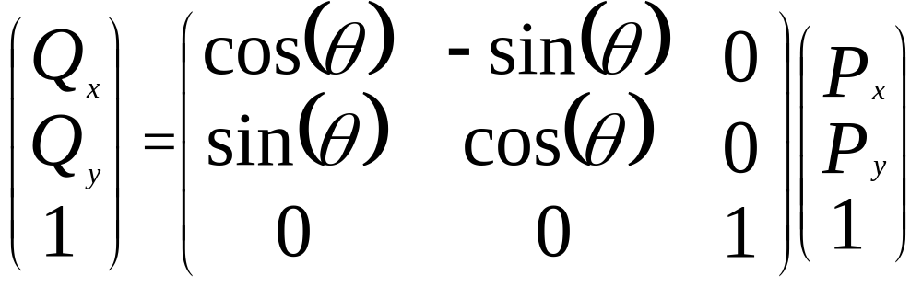
Rotation
Counterclockwise around origin by angle θ:

Slide 35
Deriving the Rotation Matrix
P is at distance R from the origin, at angle Φ; then P = (R cos(Φ), R sin(Φ)).
Q must be at the same distance as P, and at angle θ + Φ: Q =(R cos(θ + Φ), R sin(θ + Φ)).
cos(θ + Φ) = cos(θ) cos(Φ) - sin(θ) sin(Φ); sin(θ + Φ) = sin(θ) cos(Φ) + cos(θ) sin(Φ).
Use P_{x} = R cos(Φ) and P_{y} = R sin(Φ).

Slide 36
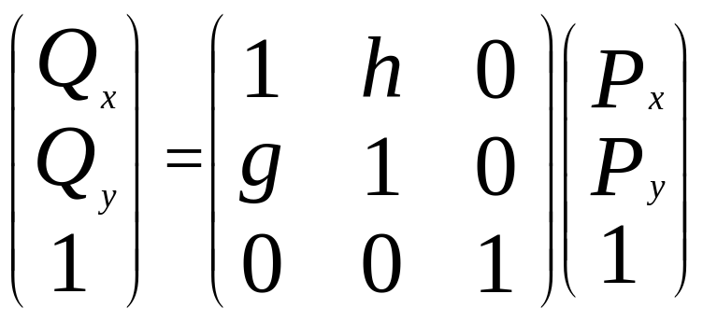
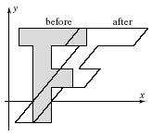
Shear
Shear H about origin: x depends linearly on y in the figure.
Shear along x: h ≠ 0, and P_{x} depends on P_{y} (for example, italic letters).
Shear along y: g ≠ 0, and P_{y} depends on P_{x}.

Slide 37
Inverses of Affine Transformations
det(M) = m₁₁*m₂₂ - m₂₁*m₁₂ 0 means that the inverse of a transformation exists.
  That is, the transformation can be "undone“.
M M⁻¹ = M⁻¹M = I, the identity matrix (ones down the major diagonal and zeroes elsewhere).

Slide 38
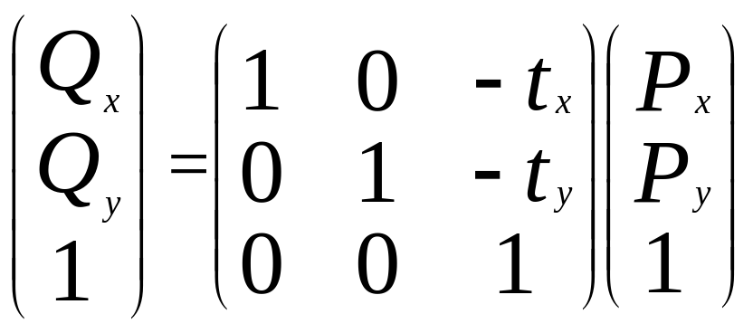
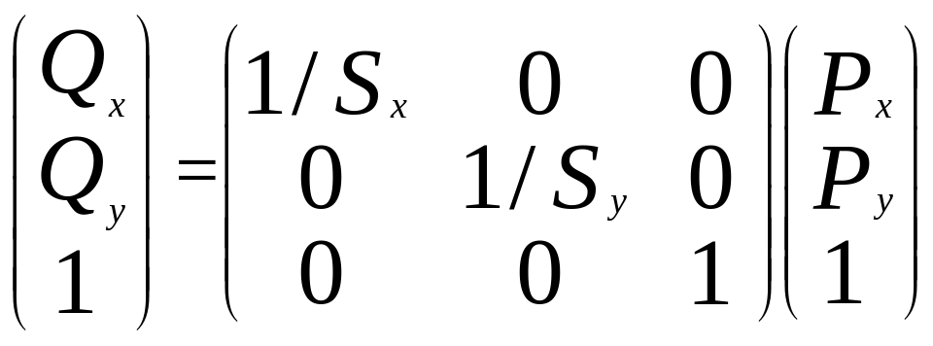
Inverse Translation and Scaling
Inverse of translation T⁻¹:
Inverse of scaling
S⁻¹:

Slide 39
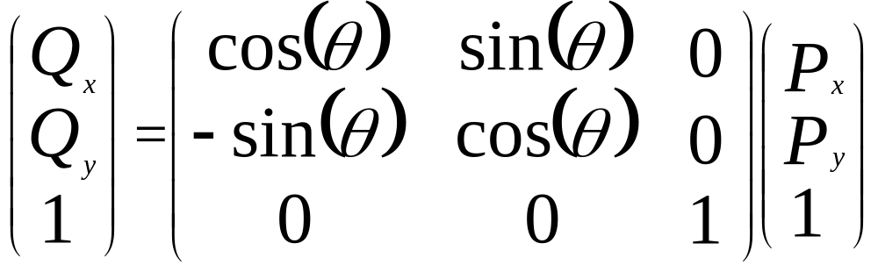
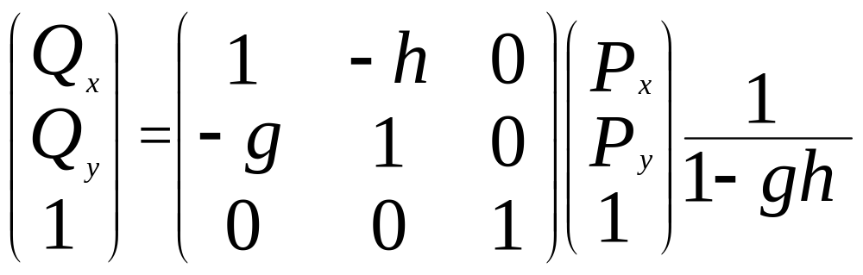
Inverse Rotation and Shear
Inverse of rotation R⁻¹ = R(-θ):
Inverse of shear H⁻¹: generally h=0 or g=0.

Slide 40
Composing Affine Transformations
Usually, we want to apply several affine transformations in a particular order to the figures in a scene: for example,
  translate by (3, - 4)
  then rotate by 30º
  then scale by (2, - 1) and so on.
Applying successive affine transformations is called composing affine transformations.

Slide 41
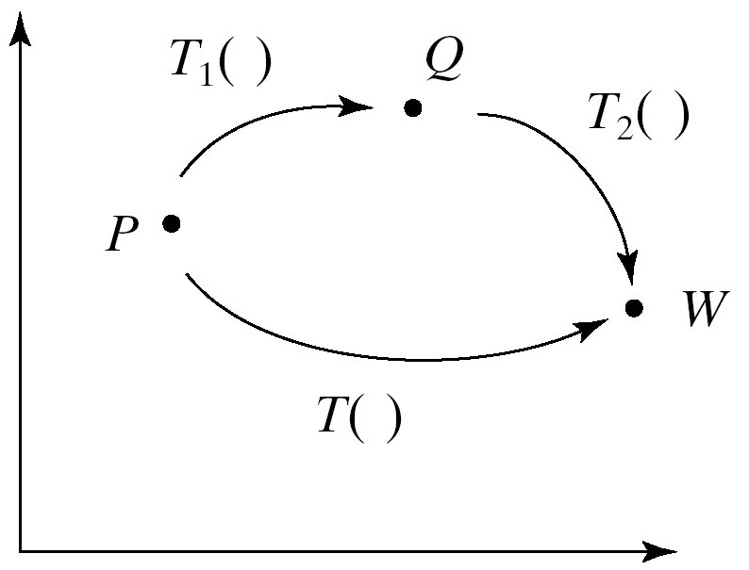
Composing Affine Transformations (2)
T₁( ) maps P into Q, and T₂( ) maps Q into point W. Is W = T₂(Q) = T₂(T₁(P))affine?
Let T₁=M₁ and T₂=M₂, where M₁ and M₂ are the appropriate matrices.
W = M₂(M₁P)) = (M₂M₁)P =MP by associativity.
So M = M₂M₁, the product of 2 matrices (in reverse order of application), which is affine.

Slide 42
Composing Affine Transformations: Examples
To rotate around an arbitrary point: translate P to the origin, rotate, translate P back to original position. Q = T_{P} R T_{-P} P
Shear around an arbitrary point: Q = T_{P} H T_{-P} P
Scale about an arbitrary point:
Q = T_{P}ST_{-P} P

Slide 43
Composing Affine Transformations (Examples)
Reflect across an arbitrary line through the origin O: Q = R(θ) S R(-θ) P
The rotation transforms the axis to the x-axis, the reflection is a scaling, and the last rotation transforms back to the original axis.
Window-viewport: Translate by -w.l, -w.b, scale by A, B, translate by v.l, v.b.

Slide 44
Properties of 2D and 3D Affine Transformations
Affine transformations preserve affine combinations of points.
  W = a₁P₁ + a₂P₂ is an affine combination.
  MW = a₁MP₁ + a₂MP₂
Affine transformations preserve lines and planes.
  A line through A and B is L(t) = (1-t)A + tB, an affine combination of points.
  A plane can also be written as an affine combination of points: P(s, a) = sA + tB +(1 – s – t)C.

Slide 45
Properties of Transformations (2)
Parallelism of lines and planes is preserved.
  Line A + bt having direction b transforms to the line given in homogeneous coordinates by M(A + bt) = MA + Mbt, which has direction vector Mb.
  Mb does not depend on point A. Thus two different lines A₁+ bt and A₂ + bt that have the same direction will transform into two lines both having the direction, so they are parallel.
An important consequence of this property is that parallelograms map into other parallelograms.

Slide 46
Properties of Transformations (3)
The direction vectors for a plane also transform into new direction vectors independent of the location of the plane.
As a consequence, parallelepipeds map into other parallelepipeds.

Slide 47
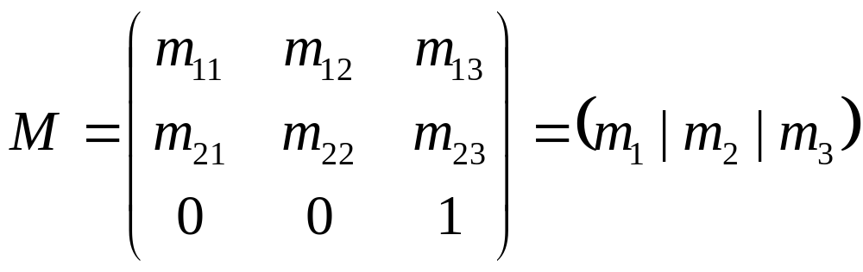
Properties of Transformations (4)
The columns of the matrix reveal the transformed coordinate frame:
  Vector i transforms into column m₁, vector j into column m₂, and the origin O into point m₃.
  The coordinate frame (i, j, O) transforms into the coordinate frame (m₁, m₂, m₃), and these new objects are precisely the columns of the matrix.

Slide 48
Properties of Transformations (5)
The axes of the new coordinate frame are not necessarily perpendicular, nor must they be unit length.
  They are still perpendicular if the transformation involves only rotations and uniform scalings.
Any point P = P_{x}i + P_{y}j + O transforms into Q = P_{x}m₁ + P_{y}m₂ + m₃.

Slide 49
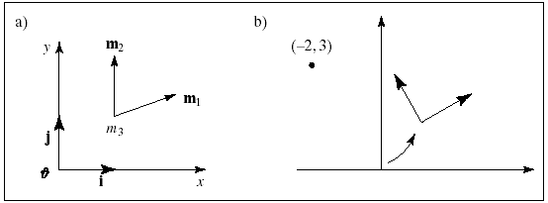
Properties of Transformations (6)

Slide 50
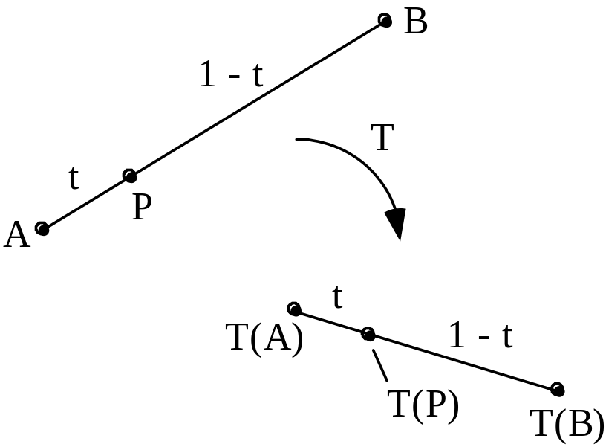
Properties of Transformations (7)
Relative ratios are preserved: consider point P lying a fraction t of the way between two given points, A and B (see figure).
Apply affine transformation T( ) to A , B, and P.
The transformed point, T(P), lies the same fraction t of the way between images T(A) and T(B).

Slide 51
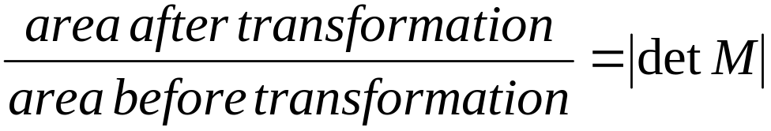
Properties of Transformations (8)
How is the area of a figure affected by an affine transformation?
It is clear that neither translations nor rotations have any effect on the area of a figure, but scalings certainly do, and shearing might.
The result is simple: When the 2D transformation with matrix M is applied to an object, its area is multiplied by the magnitude of the determinant of M:

Slide 52
Properties of Transformations (9)
In 2D the determinant of the matrix M is (m₁₁m₂₂ – m₁₂m₂₁).
For a pure scaling, the new area is S_{x}S_{y} times the original area, whereas for a shear along one axis the new area is the same as the original area.
In 3D similar arguments apply, and we can conclude that the volume of a 3D object is scaled by |det M| when the object is transformed by the 3D transformation based on matrix M.

Slide 53
Properties of Transformations (10)
Every affine transformation is composed of elementary operations.
A matrix may be factored into a product of elementary matrices in various ways. One particular way of factoring the matrix associated with a 2D affine transformation yields
M = (shear)(scaling)(rotation)(translation)
That is, any 3 x 3 matrix that represents a 2D affine transformation can be written as the product of (reading right to left) a translation matrix, a rotation matrix, a scaling matrix, and a shear matrix.

